Slide 1
Bioinformatics

Slide 2
Definition:
Bioinformatics is an interdisciplinary field that develops methods and software tools for understanding biological data, in particular when the data sets are large and complex. As an interdisciplinary field of science, bioinformatics combines biology, computer science, information engineering, mathematics and statistics to analyze and interpret the biological data.

Slide 3
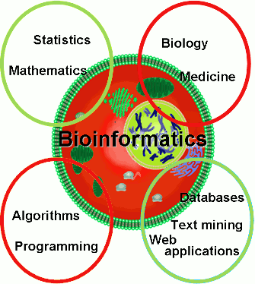
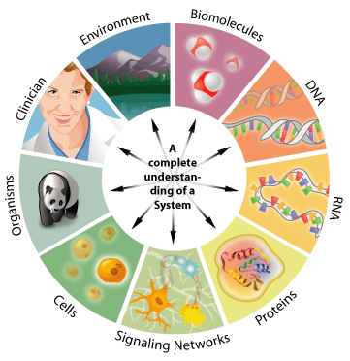
Bioinformatics:
Bioinformatics Position in relation with other fields of science

Slide 4
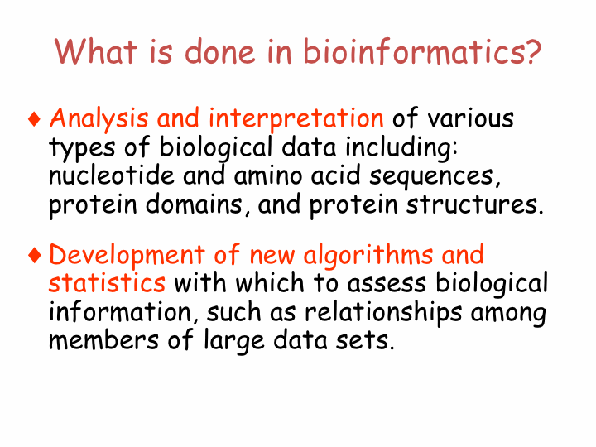

Slide 5
Level of organization to deal with

Slide 6
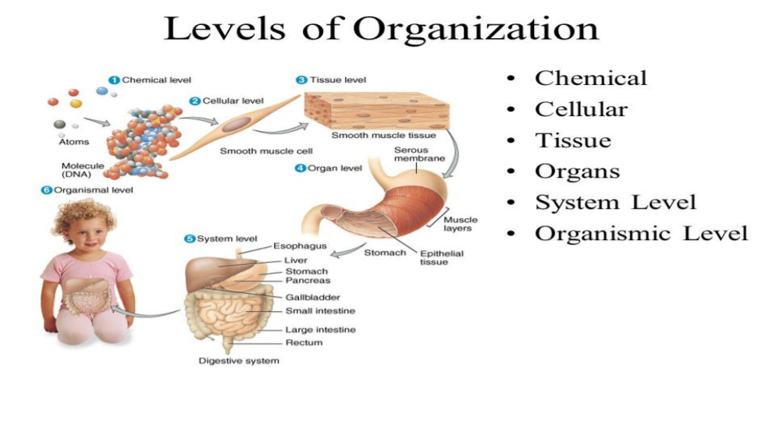

Slide 7
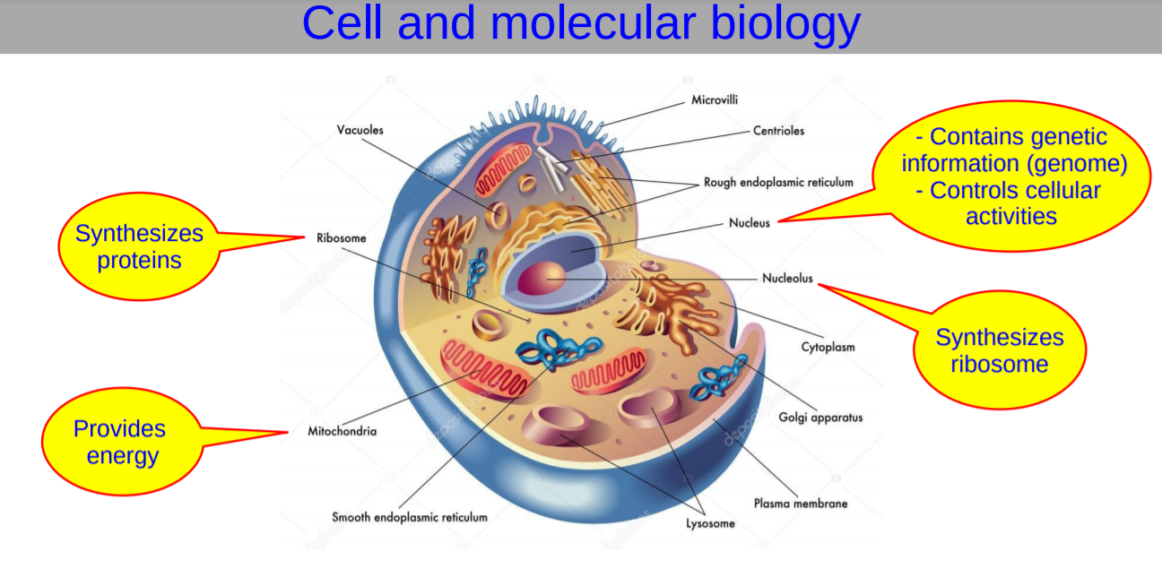

Slide 8
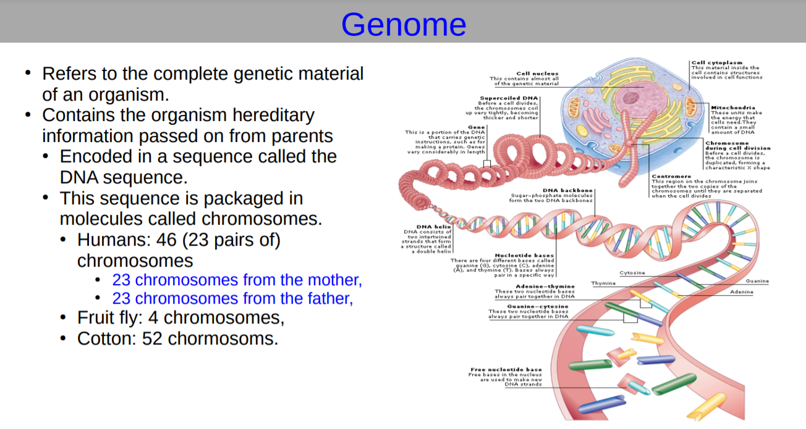

Slide 9
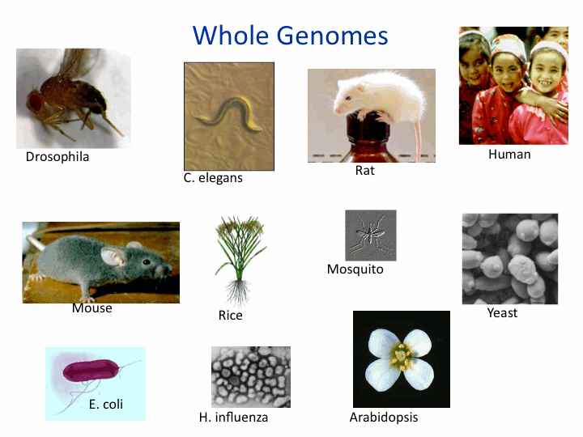

Slide 10
Goals and Techniques

Slide 11
Goals:
To study how normal cellular activities are altered in different disease states.
Common activities in bioinformatics include mapping and analyzing DNA and protein sequences, aligning DNA and protein sequences to compare them.
Increasing the understanding of biological processes, what sets it apart from other approaches, however, is its focus on developing and applying computationally intensive techniques to achieve this goal.

Slide 12
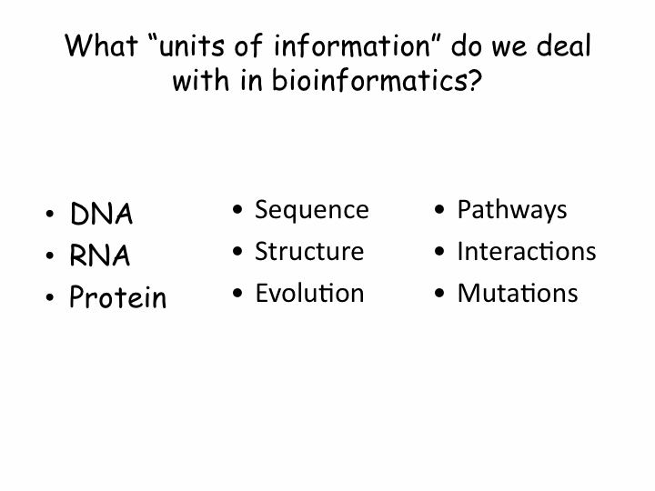

Slide 13
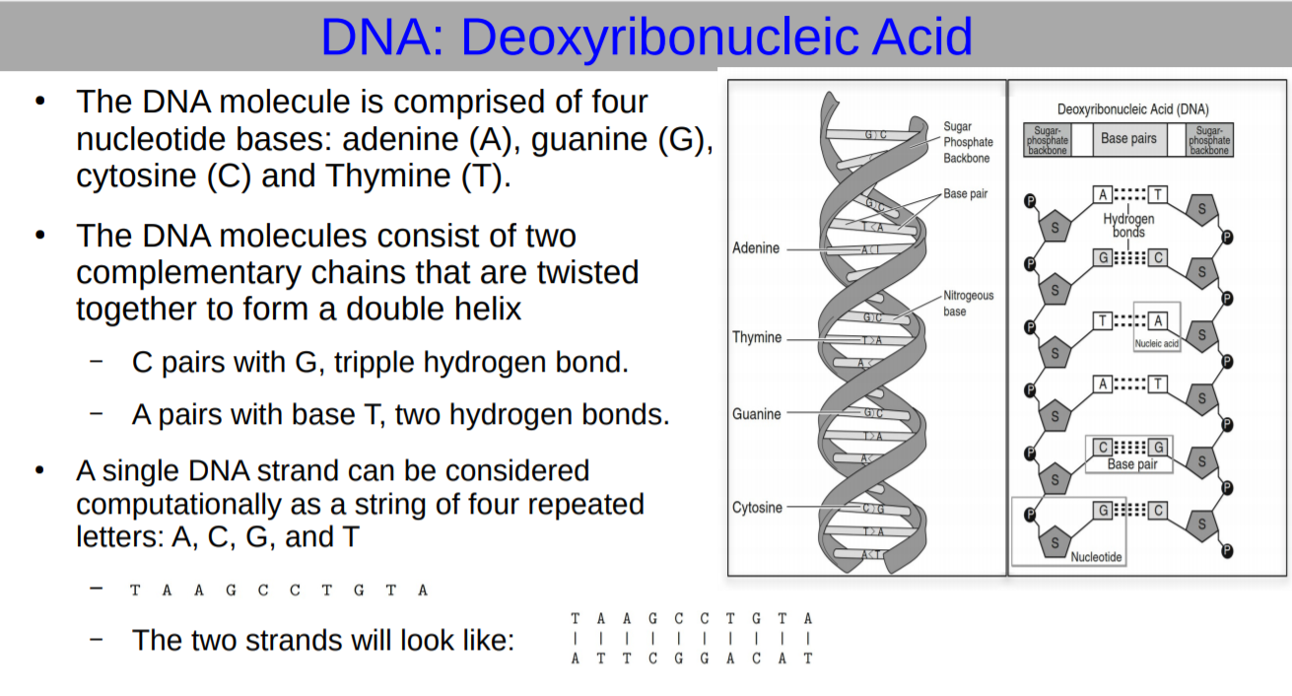

Slide 14
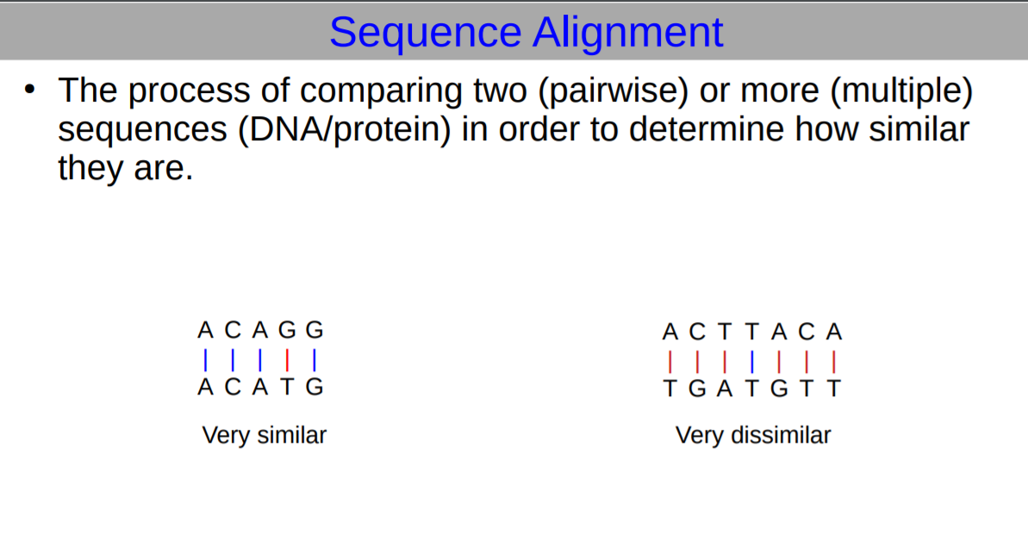

Slide 15
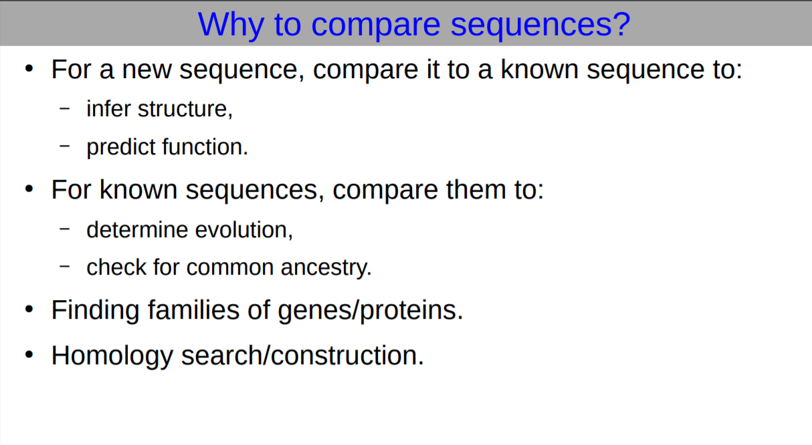

Slide 16
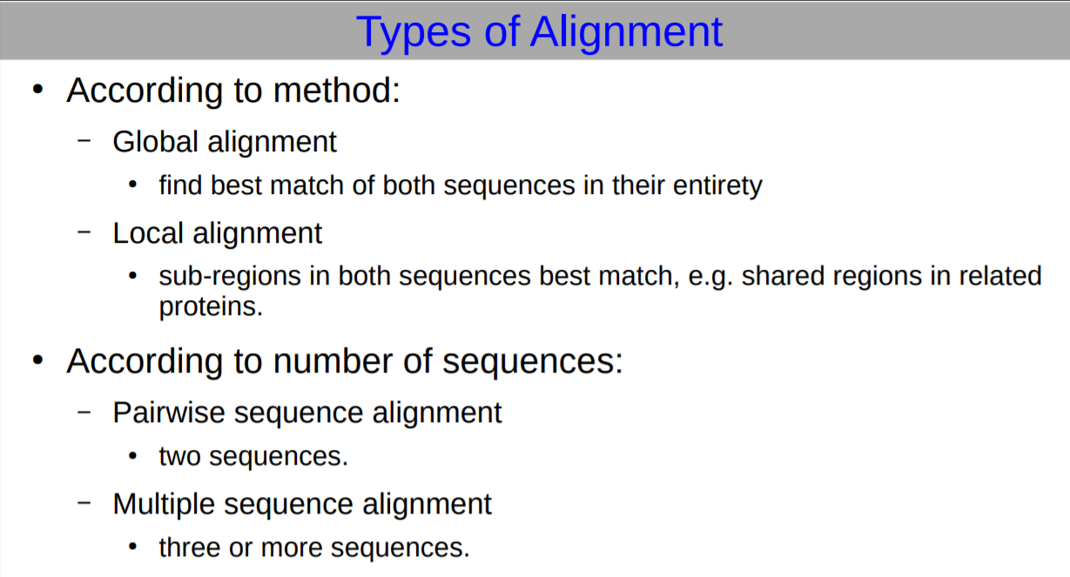

Slide 17
Historical Overview

Slide 18
Importance of databases:
Databases are essential for bioinformatics research and applications. Many databases exist, covering various information types: for example:
DNA
Protein sequences

Slide 19
Brief history of bioinformatics: (Databases)
The first biological database - Protein Identification Resource was established in 1972 by Margaret Dayhoff
Dayhoff and co-workers organized the proteins into families and superfamilies based on degree of sequence similarity
Idea of sequence alignment was introduced as well as special tables that reflected the frequency of changes observed in the sequences of a group of closely related proteins
Currently there are several huge Protein Banks : SwissProt, PIR International, etc.
The first DNA database was established in 1979. Currently there are several powerful databases: GenBank, EMBL, DDBJ, etc.

Slide 20
Brief history of bioinformatics: other important steps
Development of sequence retrieval methods (1970-80s)
Development of principles of sequence alignment (1980s)
Prediction of RNA secondary structure (1980s)
Prediction of protein secondary structure and 3D (1980-90s)
The FASTA and BLAST methods for DB search (1980-90s)
Prediction of genes (1990s)
Studies of complete genome sequences (late 1990s –2000s)

Slide 21
APPLICATIONS

Slide 22
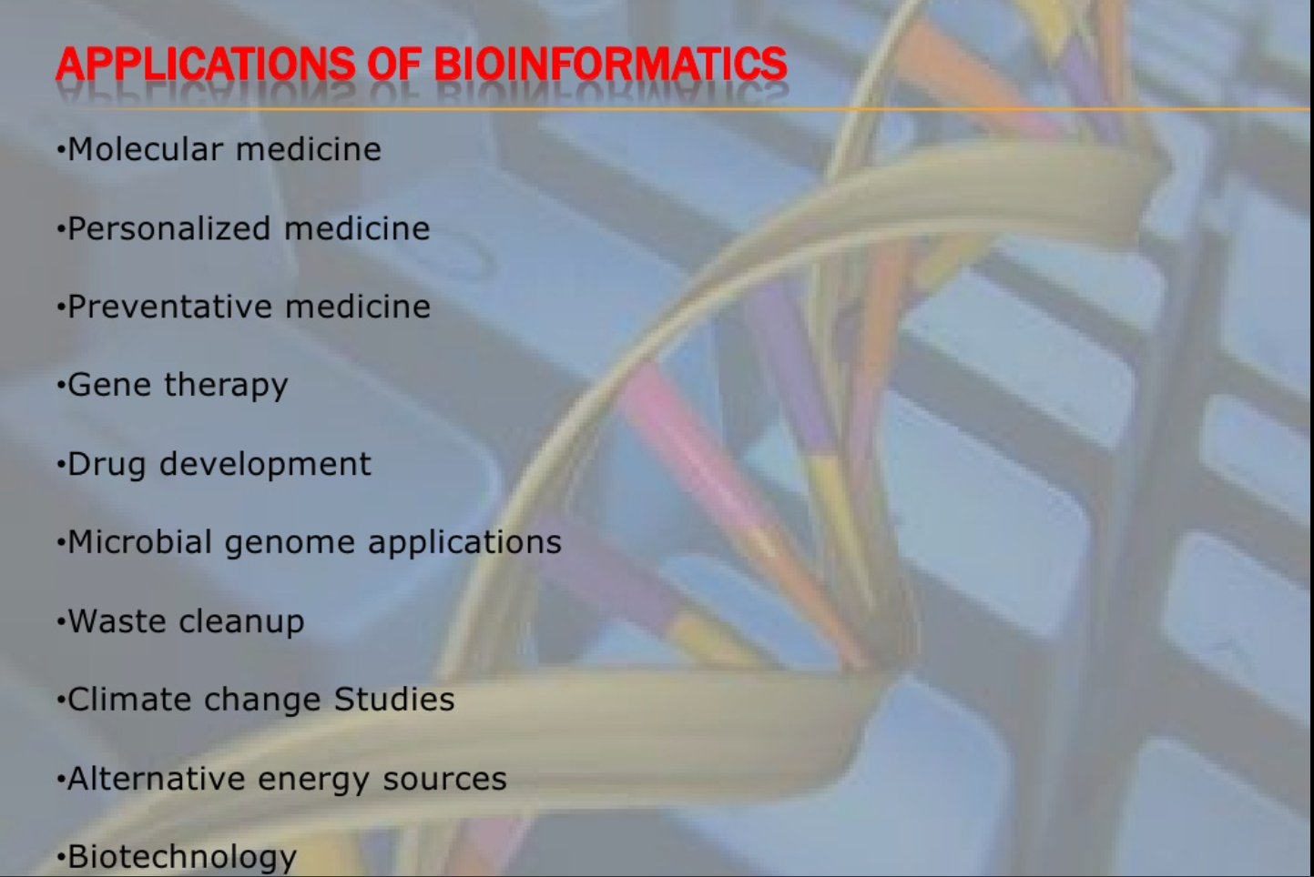

Slide 23
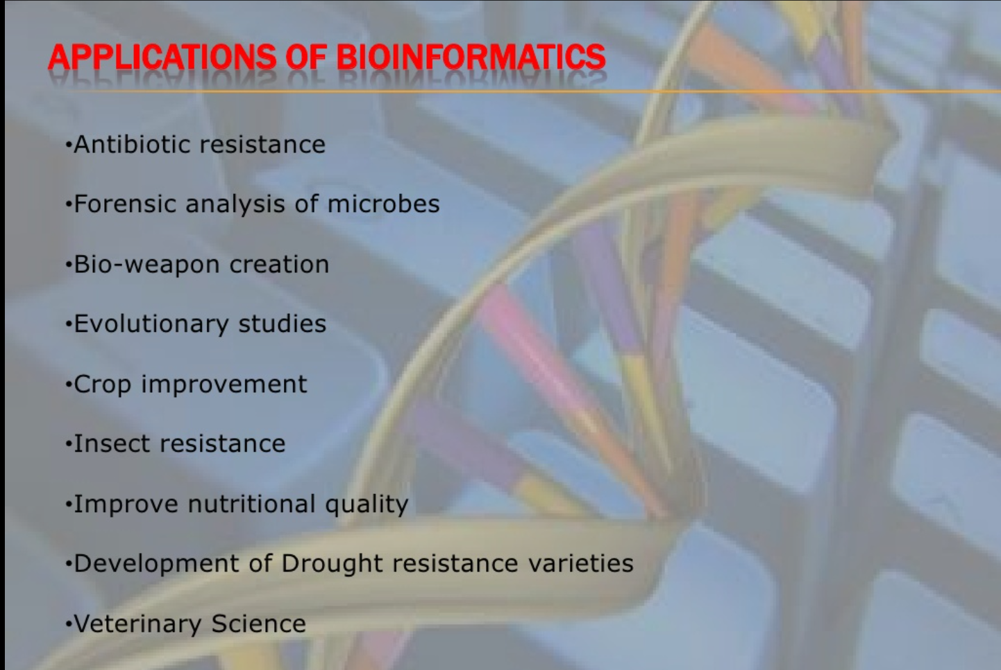

Slide 24
Thanks ☺

